Slide 1


<Shamila Habib>
<12/21/2023>

Slide 2

Outline
Executive Summary
Introduction
Methodology
Results
Conclusion
Appendix

Slide 3
Executive Summary
In this capstone project, we will predict if the SpaceX Falcon 9 first stage will land successfully using several machine learning classification algorithms. The main steps in this project include:
Data collection, wrangling, and formatting
Exploratory data analysis
Interactive data visualization
Machine learning prediction
Our graphs show that some features of the rocket launches have a correlation with the outcome of the launches, i.e., success or failure. It is also concluded that decision tree may be the best machine learning algorithm to predict if the Falcon 9 first stage will land successfully.

Slide 4
Introduction
In this capstone, we will predict if the Falcon 9 first stage will land successfully. SpaceX advertises Falcon 9 rocket launches on its website with a cost of 62 million dollars; other providers cost upward of 165 million dollars each, much of the savings is because SpaceX can reuse the first stage. Therefore if we can determine if the first stage will land, we can determine the cost of a launch. This information can be used if an alternate company wants to bid against SpaceX for a rocket launch.
Most unsuccessful landings are planned. Sometimes, SpaceX will perform a controlled landing in the ocean. The main question that we are trying to answer is, for a given set of features about a Falcon 9 rocket launch which include its payload mass, orbit type, launch site, and so on, will the first stage of the rocket land successfully?

Slide 5

Section 1

Slide 6
Methodology
The overall methodology includes:
Data collection, wrangling, and formatting, using:
SpaceX API
Web scraping
Exploratory data analysis (EDA), using:
Pandas and NumPy
SQL
Data visualization, using:
Matplotlib and Seaborn
Folium
Dash
Machine learning prediction, using
Logistic regression
Support vector machine (SVM)
Decision tree
K-nearest neighbors (KNN)

Slide 7
Data Collection
Describe how data sets were collected.
You need to present your data collection process use key phrases and flowcharts

Slide 8
Data Collection – SpaceX API
1_Data Collection API.ipynb
Libraries or modules used: requests, pandas, numpy, datetime
The API used is here.
The API provides data about many types of rocket launches done by SpaceX, the data is therefore filtered to include only Falcon 9 launches.
The API is accessed using requests.get().
The json result is converted to a dataframe using the json_normalize() function from pandas.
Every missing value in the data is replaced the mean the column that the missing value belongs to.
We end up with 90 rows or instances and 17 columns or features.

Slide 9
Data Collection - Scraping
2_Data Collection with Web Scraping.ipynb
Libraries or modules used: sys, requests, BeautifulSoup from bs4, re, unicodedata, pandas
The data is scraped from List of Falcon 9 and Falcon Heavy launches.
The website contains only the data about Falcon 9 launches.
First, the Falcon9 Launch Wiki page is requested from the url and a BeautifulSoup object is created from response of requests.get().
Next, all column/variable names are extracted from the HTML table header by using the find_all() function from BeautifulSoup.
A dataframe is then created with the extracted column names and entries filled with launch records extracted from table rows.
We end up with 121 rows or instances and 11 columns or features.

Slide 10
zero if the corresponding row in Outcome is in the set bad_outcome; otherwise, it's one
Data Wrangling
2_Data wrangling.ipynb
Libraries or modules used: pandas, numpy
SpaceX dataset was loaded from here.
First, we identified and calculated the percentage of the missing values in each attribute.
We calculated the number of launches on each site, number and occurrence of each orbit, number and occurrence of mission outcome of the orbits.
Then we created a landing outcome label from Outcome Column. Using the Outcome, we created a list where the element is zero if the corresponding row in Outcome is in the set bad_outcome; otherwise, it's one.
Lastly we calculated the success rate.

Slide 11
EDA with Data Visualization
3_EDA.ipynb
Exploratory Data Analysis performed on variables Flight Number, Payload Mass, Launch Site, Orbit, Class and Year.
Plots Used:
Flight Number vs. Payload Mass, Flight Number vs Launch Site, Payload Mass vs. Launch Site, Orbit vs. Success Rate, Flight Number vs. Orbit, Payload vs Orbit, and Success Yearly Trend Scatter plots, line charts and bar plots were used to compare relationships between variables to decide if a relationship exists so that they could be used in training the machine learning model.

Slide 12
EDA with SQL
4_EDA with SQL.ipynb
Framework used: IBM DB2
Libraries or modules used: ibm_db
The data is queried using SQL to answer several questions about the data such as:
The names of the unique launch sites in the space mission
The total payload mass carried by boosters launched by NASA (CRS)
The average payload mass carried by booster version F9 v1.1
The SQL statements or functions used include SELECT, DISTINCT, AS, FROM, WHERE, LIMIT, LIKE, SUM(), AVG(), MIN(), BETWEEN, COUNT(), and YEAR().

Slide 13
Build an Interactive Map with Folium
6_Interactive Visual Analytics with Folium lab.ipynb
Libraries or modules used: folium, wget, pandas, math
Functions from the Folium libraries are used to visualize the data through interactive maps. The Folium library is used to:
Mark all launch sites on a map
Mark the succeeded launches and failed launches for each site on the map
Mark the distances between a launch site to its proximities such as the nearest city, railway, or highway
These are done using functions from folium such as add_child() and folium plugins which include MarkerCluster, MousePosition, and DivIcon.
Example: A folium map showing the succeeded launches and failed launches for a specific launch site. If we zoom in on one of the launch site, we can see green and red tags. Each green tag represents a successful launch while each red tag represents a failed launch.

Slide 14
Build a Dashboard with Plotly Dash
7_spacex_dash_app.py
Libraries or modules used: pandas, dash, dash_html_components, dash_core_components, Input and Output from dash.dependencies, plotly.express
Functions from Dash are used to generate an interactive site where we can toggle the input using a dropdown menu and a range slider. Using a pie chart and a scatterplot, the interactive site shows:
The total success launches from each launch site
The correlation between payload mass and mission outcome (success or failure) for each launch site
The application is launched on a terminal on the IBM Skills Network website.
The picture below shows a pie chart when launch site CCAFS LC-40 is chosen in the dropdown menu on the website. 0 represents failed launches while 1 represents successful launches. We can see that 73.1% of launches done at CCAFS LC-40 are failed launches.

Slide 15
Predictive Analysis (Classification)
8_Machine Learning Prediction.ipynb
Libraries or modules used: pandas, numpy, matplotlib.pyplot, seaborn, sklearn
Functions from the Scikit-learn library are used to create our machine learning models. The machine learning prediction phase include the following steps:
Standardizing the data using the preprocessing.StandardScaler() function from sklearn
Splitting the data into training and test data using the train_test_split function from sklearn.model_selection
Creating machine learning models, which include:
Logistic regression using LogisticRegression from sklearn.linear_model
Support vector machine (SVM) using SVC from sklearn.svm
Decision tree using DecisionTreeClassifier from sklearn.tree
K nearest neighbors (KNN) using KNeighborsClassifier from sklearn.neighbors
Fit the models on the training set
Find the best combination of hyperparameters for each model using GridSearchCV from sklearn.model_selection
Evaluate the models based on their accuracy scores and confusion matrix using the score() function and confusion_matrix from sklearn.metrics
Putting the results of all 4 models side by side, we can see that they all share the same accuracy score and confusion matrix when tested on the test set. Therefore, their GridSearchCV best scores are used to rank them instead. Based on the GridSearchCV best scores, the models are ranked in the following order with the first being the best and the last one being the worst:
Decision tree (GridSearchCV best score: 0.8892857142857142)
K nearest neighbors, KNN (GridSearchCV best score: 0.8482142857142858)
Support vector machine, SVM (GridSearchCV best score: 0.8482142857142856)
Logistic regression (GridSearchCV best score: 0.8464285714285713)
The picture below shows the confusion matrix when the Decision Tree model is tested on the test data.

Slide 16
Results
From the data visualization section, we can see that some features may have correlation with the mission outcome in several ways. For example, with heavy payloads the successful landing or positive landing rate are more for orbit types Polar, LEO and ISS. However, for GTO, we cannot distinguish this well as both positive landing rate and negative landing(unsuccessful mission) are both there here.
Therefore, each feature may have a certain impact on the final mission outcome. The exact ways of how each of these features impact the mission outcome are difficult to decipher. However, we can use some machine learning algorithms to learn the pattern of the past data and predict whether a mission will be successful or not based on the given features.

Slide 17

Section 2

Slide 18
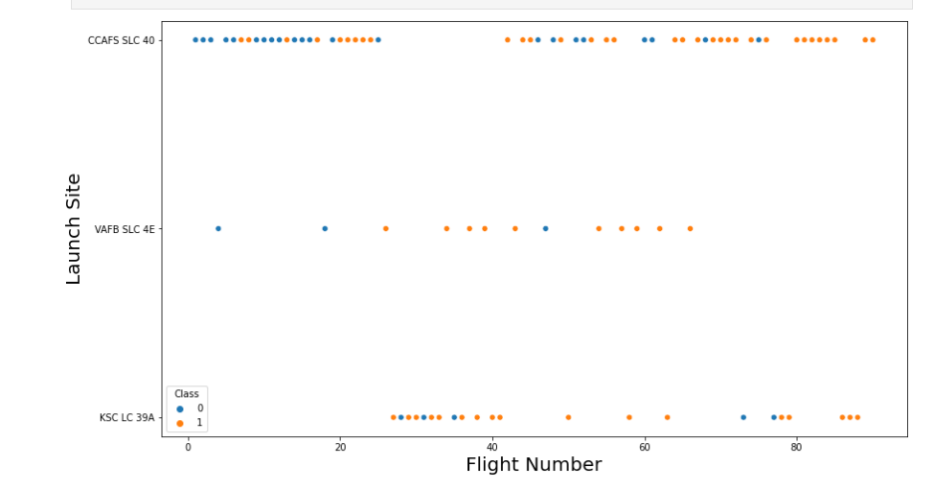
Flight Number vs. Launch Site
Graphic suggests an increase in success rate over time (indicated in Flight Number). Likely a big breakthrough around flight 20 which significantly increased success rate. CCAFS appears to be the main launch site as it has the most volume.

Slide 19
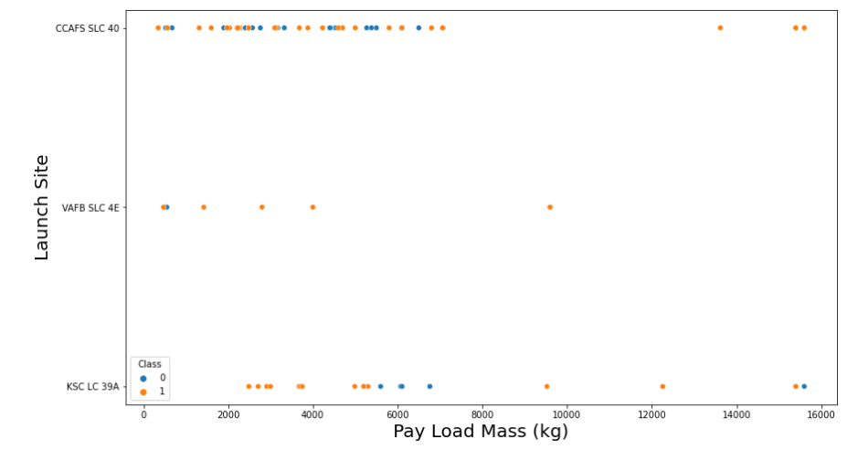
Payload vs. Launch Site
Payload mass appears to fall mostly between 0-7000 kg. Difference launch sites also seem to use different payload mass.

Slide 20
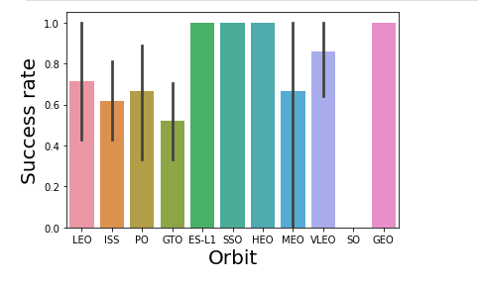
Success Rate vs. Orbit Type
ES-L1(1),GEO(1), HEO(1)have100% success rate(sample sizes in parenthesis)
SSO(5)has 100% success rate
VLEO(14) has decent success rate and attempts
SO(1) has 0% success rate
GTO(27) has around 50% success rate but largest sample

Slide 21
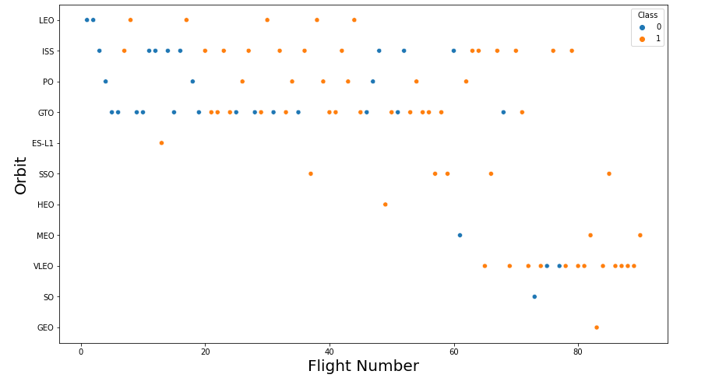
Flight Number vs. Orbit Type
Launch Orbit preferences changed over Flight Number.
Launch Outcome seems to correlate with this preference.
SpaceX started with LEO orbits which saw moderate success LEO and returned to VLEO in recent launches
SpaceX appears to perform better in lower orbits or Sun-synchronous orbits

Slide 22
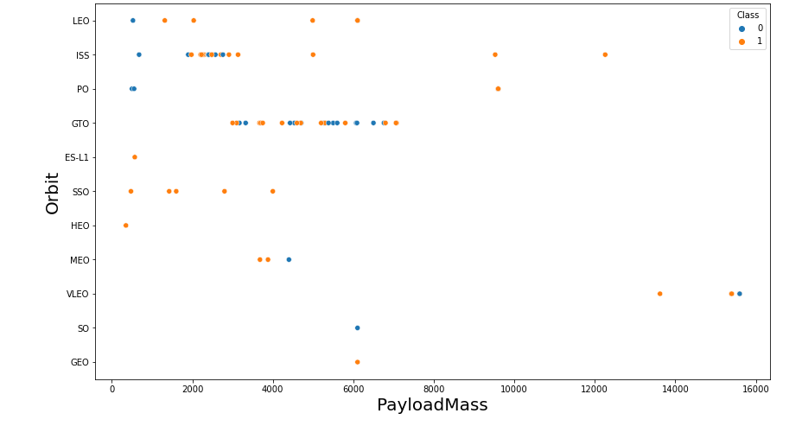
Payload vs. Orbit Type
Payload mass seems to correlate with orbit
LEO and SSO seem to have relatively low payloadmass
The other most successful orbit VLEO only has payloadmass values in the higher end of the range

Slide 23
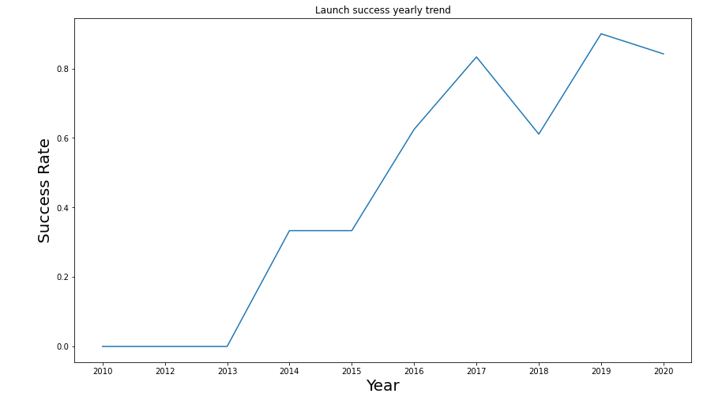
Launch Success Yearly Trend
Success generally increases over time since 2013 with a slight dip in 2018
Success in recent years at around 80%

Slide 24
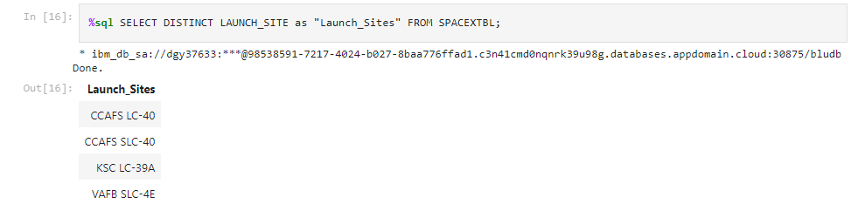
All Launch Site Names
4 unique launch sites were found from database using the sql command Distinct.

Slide 25
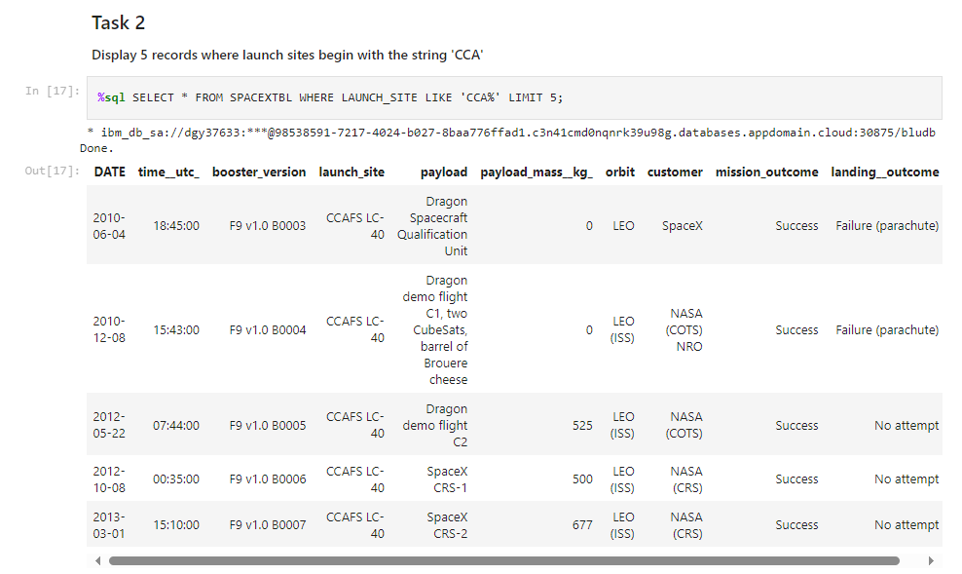
Launch Site Names Begin with 'CCA'
First five entries in database with Launch site name beginning with CCA.

Slide 26
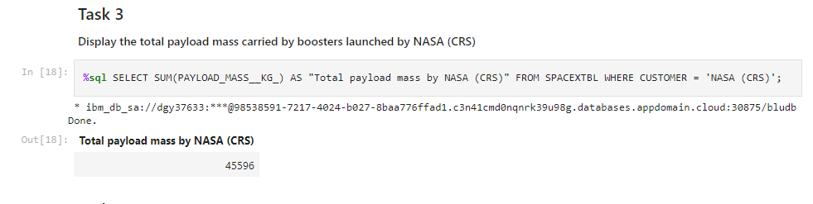
Total Payload Mass
The query sums the total payload mass in kg where NASA was the customer

Slide 27
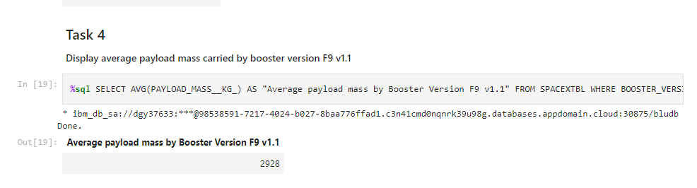
Average Payload Mass by F9 v1.1
This query calculates the average payload mass or launches which used booster version F9v1.1
Average payload mass of F9 1.1 is on the lower end of our payload mass range

Slide 28
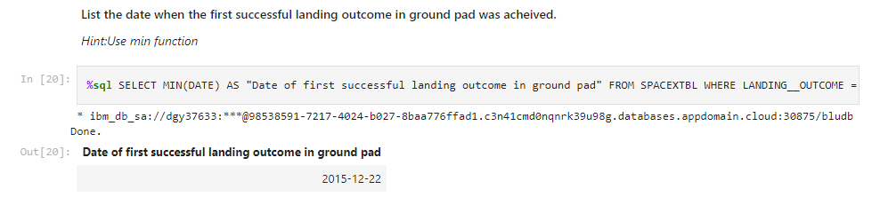
First Successful Ground Landing Date
The query indicates that the first successful landing outcome happened on 22nd December, 2015

Slide 29
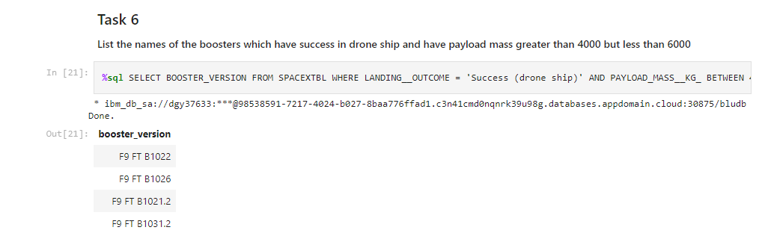
Successful Drone Ship Landing with Payload between 4000 and 6000
This query returns the four booster versions that had successful drone ship landings and a payload mass between 4000 and 6000 no inclusively.

Slide 30
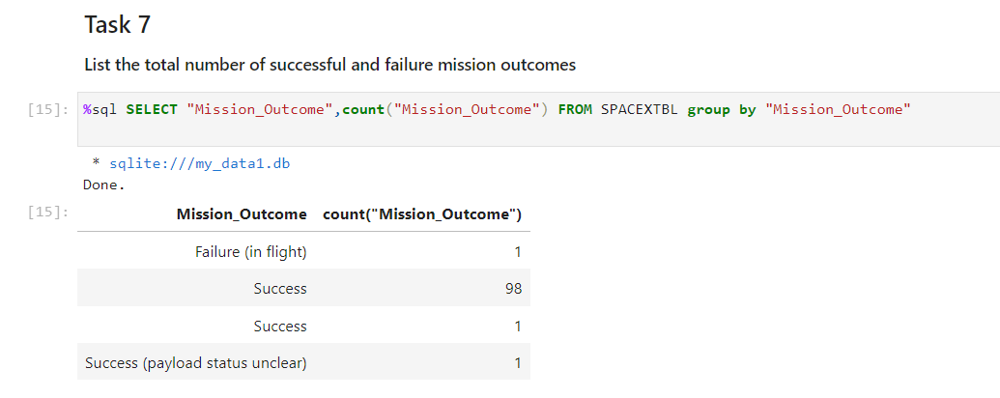
Total Number of Successful and Failure Mission Outcomes
SpaceX appears to achieve its mission outcome nearly 99% of the time. One launch has an unclear payload status and unfortunately one failed in flight.

Slide 31
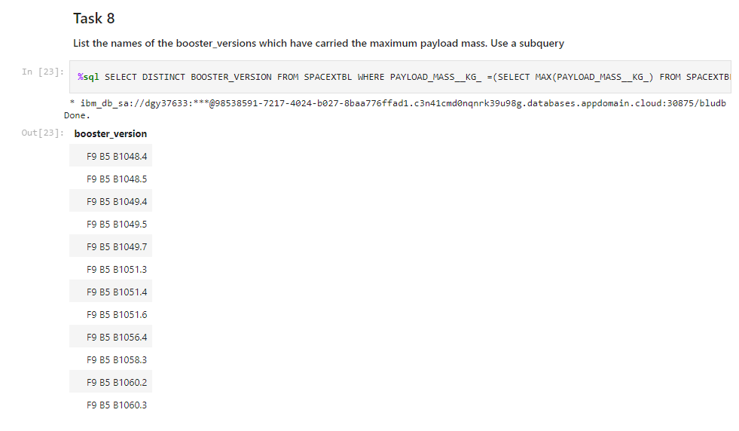
Boosters Carried Maximum Payload
This query returns the booster versions that carried the highest paload mass of 156000 kg. These booster versions are very similar and all are of the F9 B5 B10xx.x variety.
This likely indicated payload mass correlates with the booster version that is used.

Slide 32
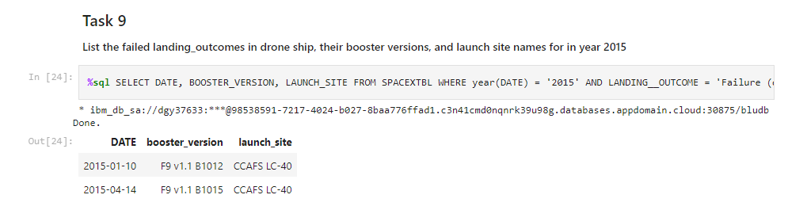
2015 Launch Records
This query shows the failed landing ourcomes in drone ship, their booster versions and launch site names for 2015

Slide 33
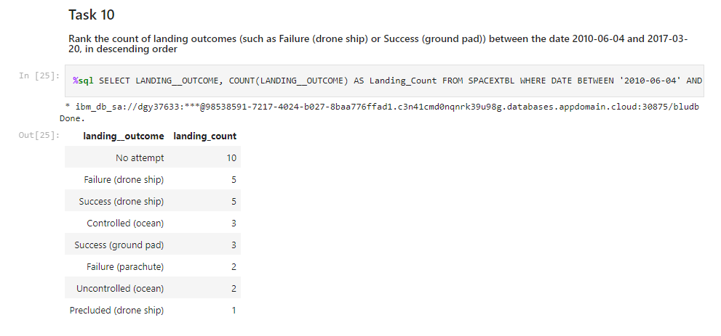
Rank Landing Outcomes Between 2010-06-04 and 2017-03-20
This query ranks the count of landing outcomes (such as Failure (drone ship) or Success (ground pad)) between the date 2010-06-04 and 2017-03-20, in descending order

Slide 34

Section 3

Slide 35
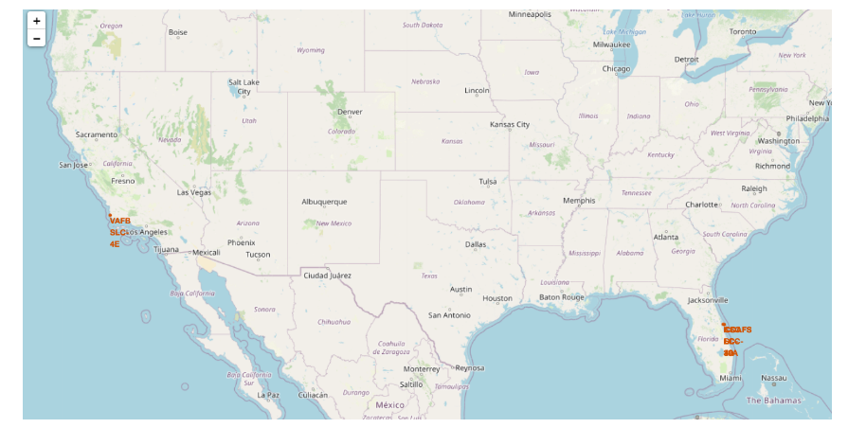
Launch Site Locations
All launch sites are near the ocean.

Slide 36
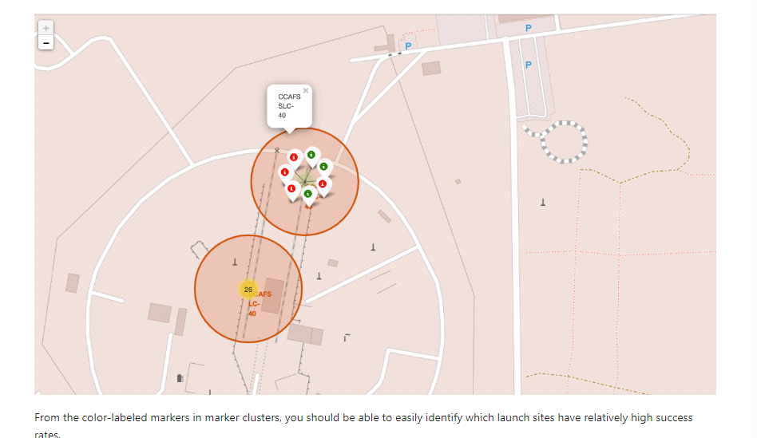
Color Coded Launch Markers
Clusters on Folium map can be clicked on to display each successful landing (green icon) and failed landing(red icon).InthisexampleVAFBSLC-4Eshows4successfullandingsand6failedlandings.

Slide 37
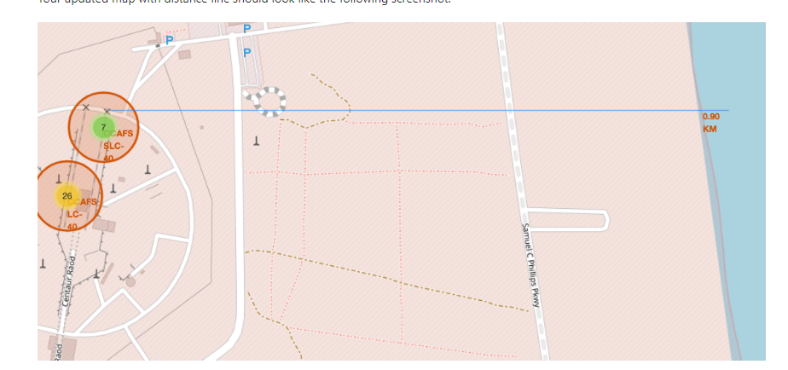
Key Location Proximities
Launch sites are very close to railways for large part and supply transportation. Launch sites are close to highways for human and supply transport. Launch sites are also close to coasts and relatively far from cities to that launch failures can land in the sea to avoid rockets falling on densely populated areas.

Slide 38

Section 4

Slide 39
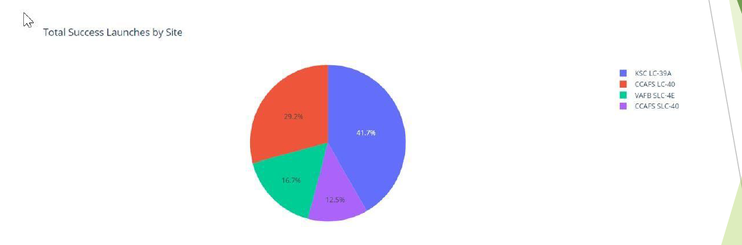
Successful Launches Across Launch Sites
This is the distribution of successful landings across all launch sites. CCAFS LC-40 is the old name of CCAFS SLC-40 so CCAFS and KSC have the same amount of successful landings, but a majority of the successful landings where performed before the name change. VAFB has the smallest share of successful landings. This may be due to smaller sample and increase in difficulty of launching in the west coast.

Slide 40
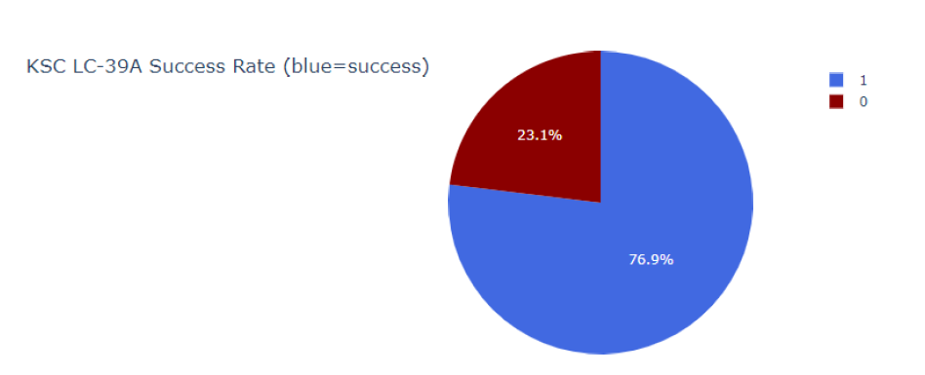
Highest Success Rate Launch Site
KSCLC-39Ahasthehighestsuccessratewith10 successfullandingsand3failedlandings.

Slide 41
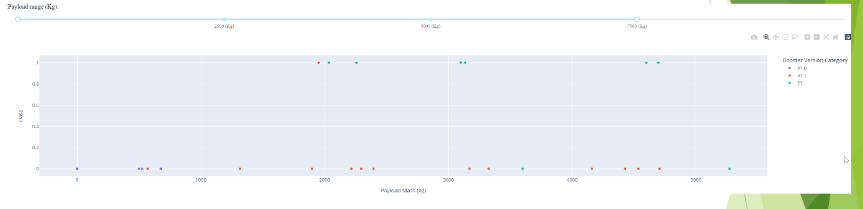
Payload Mass vs. Success vs. Booster Version Category
Plotly dashboard has a Payload range selector. However, this is set from 0-10000 instead of the max Payload of 15600. Class indicates 1 for successful landing and 0 for failure. Scatter plot also accounts for booster version category in color and number of launches in point size. In this particularrangeof0-7500,interestinglytherearetwofailedlandings with payloads of zero kg.

Slide 42

Section 5

Slide 43
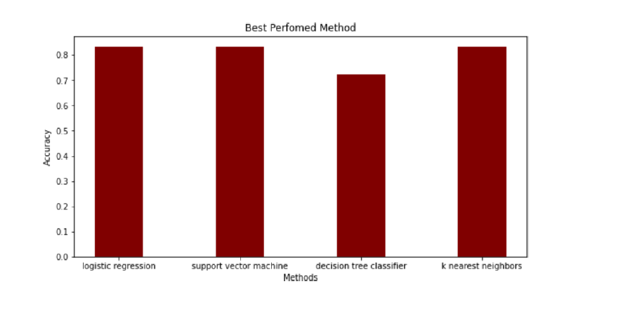
Classification Accuracy
The models had virtually the same accuracy on the test set at 83.33%accuracy, except the decisiontreeclassifierwith72.23%.
It should be noted that test size is small at only sample size of 18.
This can cause large variance in accuracy results, such as those in Decision Tree Classifier model in repeated runs. We likely need more data to determine the best model.

Slide 44
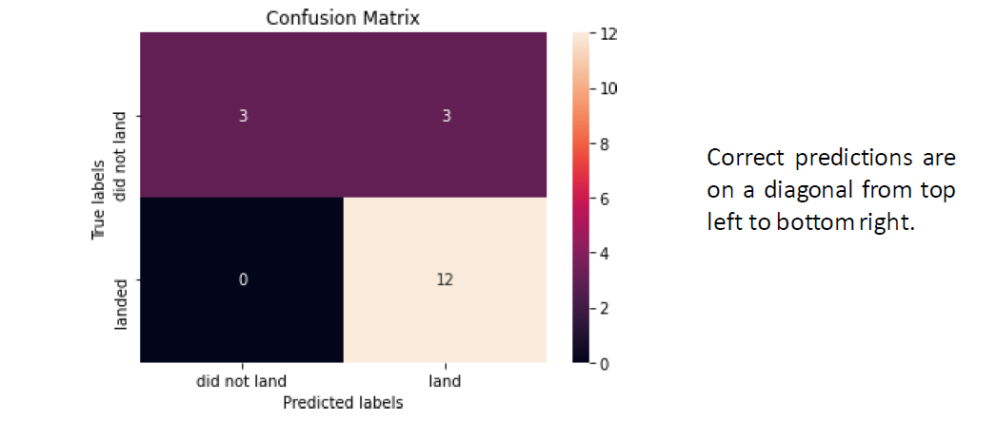
Confusion Matrix
The models predicted 12 successful landings when the true label was successful landing.
The models predicted 3 unsuccessful landings when the true label was unsuccessful landing.
The models predicted 3 successful landings when the true label was unsuccessful landings(false positives). Our models over predict successful landings.

Slide 45
Conclusions
◦Our task: to develop a machine learning model for Space Y who wants to bid against SpaceX
◦The goal of model is to predict when Stage1 will successfully land to save ~$100 million USD
◦Used data from a public SpaceX API and web scraping SpaceX Wikipedia page
◦Created data labels and stored data in to a DB2 SQL database
◦Created a dashboard for visualization
◦We created a machine learning model with an accuracy of 83%
◦Allon Mask of Space Y can use this model to predict with relatively high accuracy whether a launch will have a successful Stage 1 landing before launch to determine whether the launch should be made or not
◦More data should be collected to better determine the best machine learning model and improve the accuracy

Slide 46
Appendix
GitHub repository URL:
AnthonyWen/Capstone (github.com)

Slide 47


